Slide 1
Medicare Application
Team members :
1- Rahma Hussein
2- Sara Atef
3- Omneya Ahmed
4- Mohamed Ayman
5- Mohamed Abdallah

Slide 2
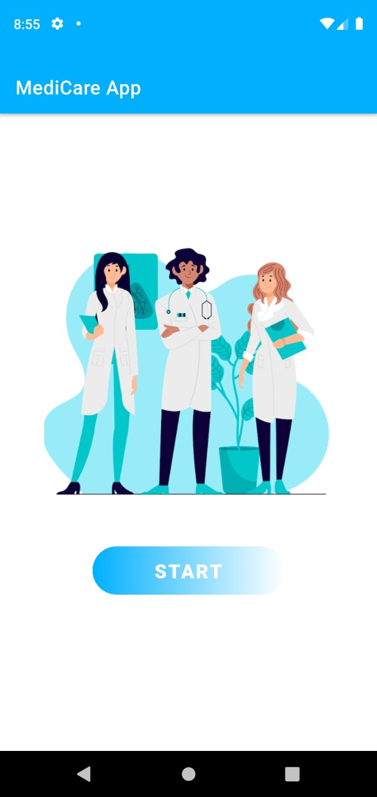
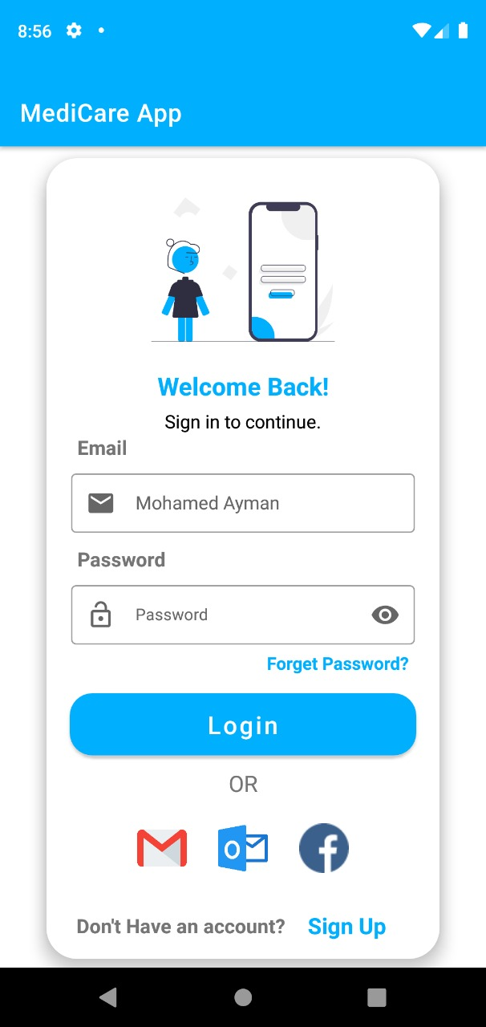
If the user logged in as an admin it takes him to the category page and it takes him to the doctors page, he chooses the best doctor for him.

Slide 3
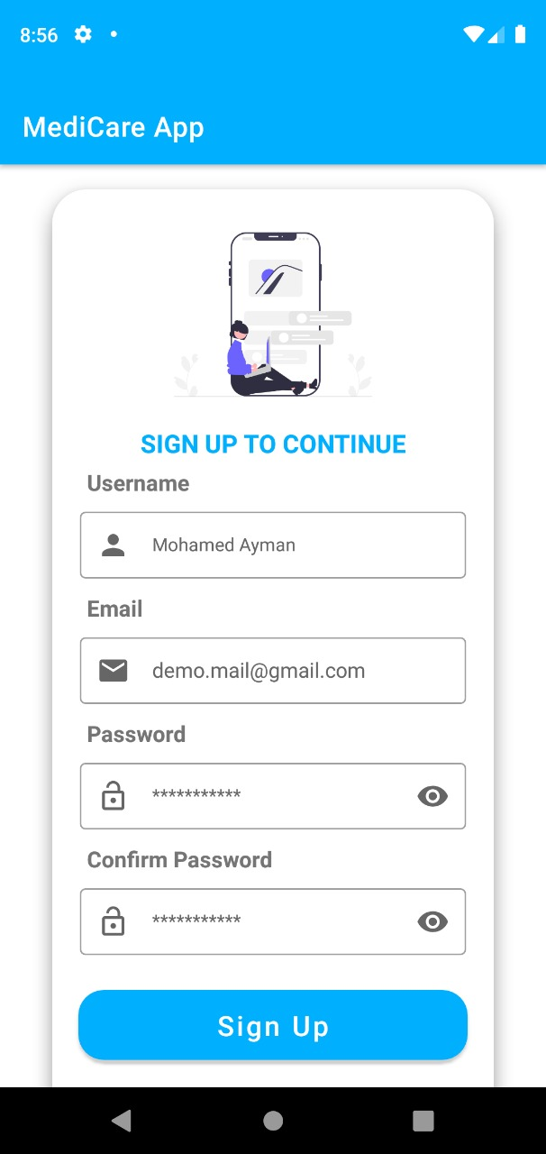
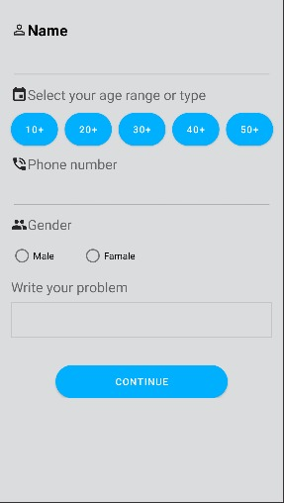
A sign up page for new users

Slide 4
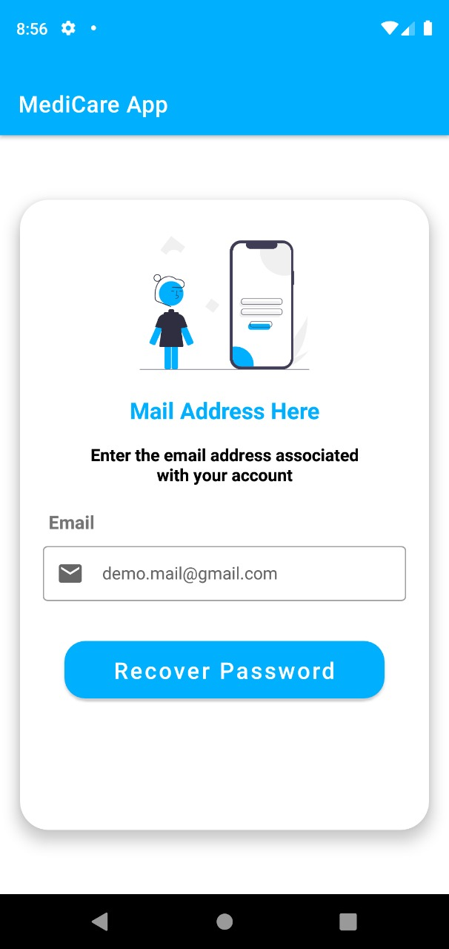
If the user forgets his password
A feature that helps the user to stay logged in if he forgets his own password

Slide 5
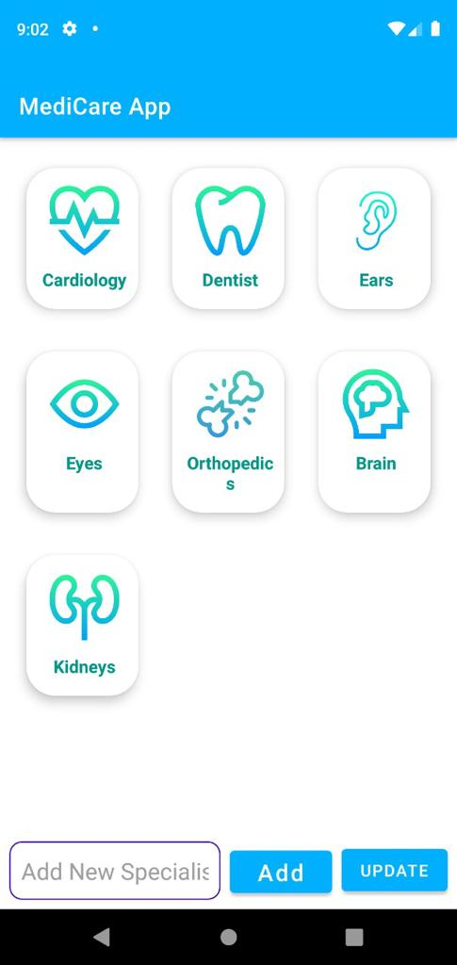
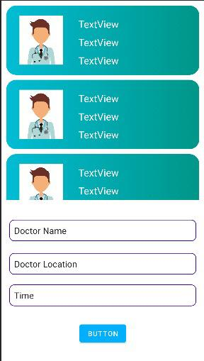
The category page helps the admin to choose which category he’s looking for and when he chooses the suitable category, the application takes him to the next page which is the Doctor’s page.
When the admin updates or add new info about the category or the doctor page, this information is stored in the database

Slide 6
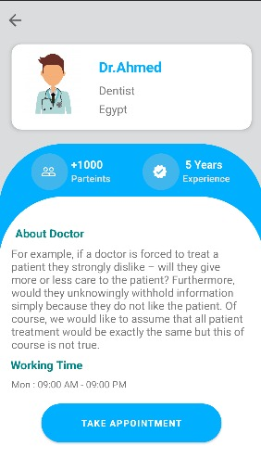
Info about chosen doctor and taking an appointment

Slide 7
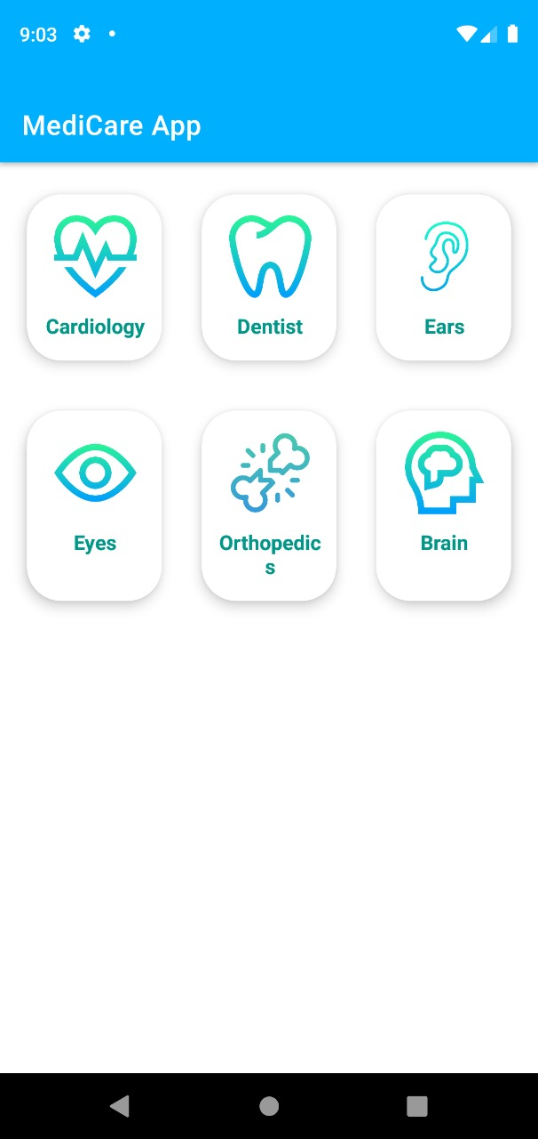
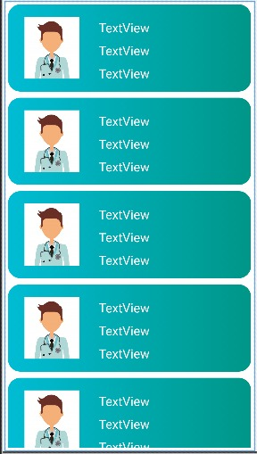
If he entered as a user, it will take him to the category page then view him a recycler view for the doctors who have profiles for the application.

Slide 8
Thank you

